Slide 1

Analysis and Visualization of Cab Rides
By~
Akshay Kumar Yadav -20mcb1015
Vishnu Shashank – 20mcb1009

Slide 2
Introduction
UBER is an American based transportation network company, which develops, markets and operates the Uber mobile app, which allows people with smartphones to add/submit a trip request based on which the Uber drivers routes their car.
Uber has covered almost all the major cities in the United States and is performing good by making it possible for anyone use a car.
New York City (NYC) is the most populous city in the United States. It is also the most densely populated major city in the United States.
The City is considered as one of the busiest place in the world and also different kind of people live in the city have their own professions and go to work or by their love place.
In this project, we analyze various data frames that has all the information’s related to Uber’s pick up date, time, latitude and longitude

Slide 3
Objective
The objective of this project is to understand the traffic in different boroughs of New York City and to try and categorize the various zones within various boroughs.
It can be office destinations, residential destination, popular brunch destination or party destination according to it’s popularity given the time-range and the day of the week.

Slide 4
Problem Understanding
There is a lot of information stored in the traffic flow data of any city.
This data when mined over location can provide information about the major attractions of the city, it can help us understand the various zones of the city such as residential areas, office/school zones, highways, etc.

Slide 5
Data Understanding
Here, two groups of files that was generated by Uber:
Uber trip data from 2014 (April - September)
Uber trip data from 2015 (January - June)
There are six files of raw data on Uber pickups in New York City from April to September 2014
The files are separated by month and each has the following columns:
Date/Time : The date and time of the Uber pickup
Lat : The latitude of the Uber pickup
Lon : The longitude of the Uber pickup
Base : The TLC base company code affiliated with the Uber pickup

Slide 6

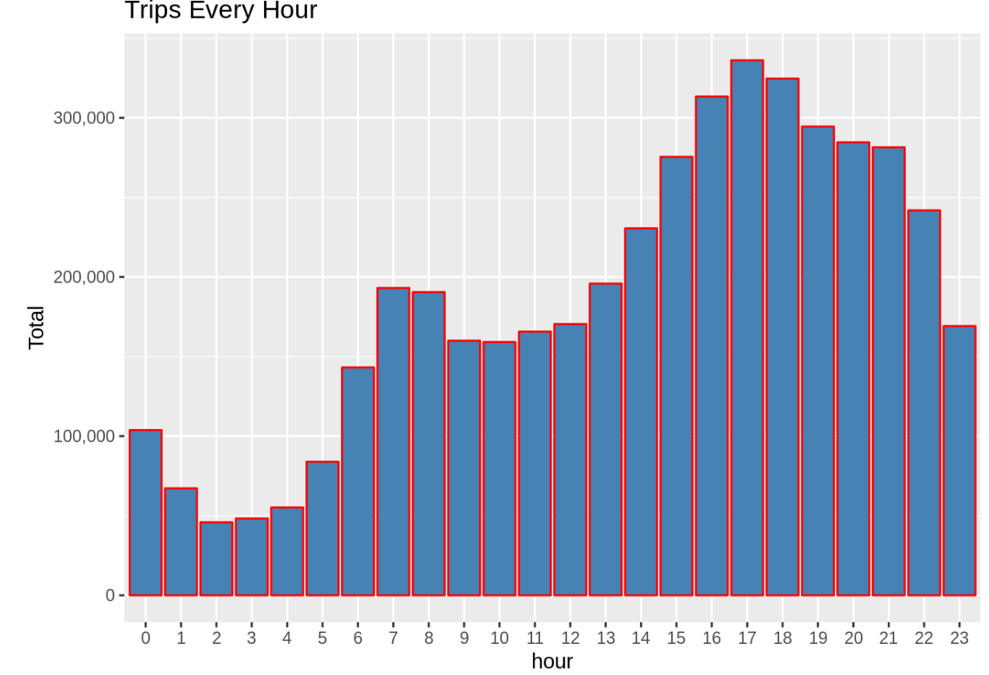
Results
Plotting data by trips during for Every Hour in a Day

Slide 7
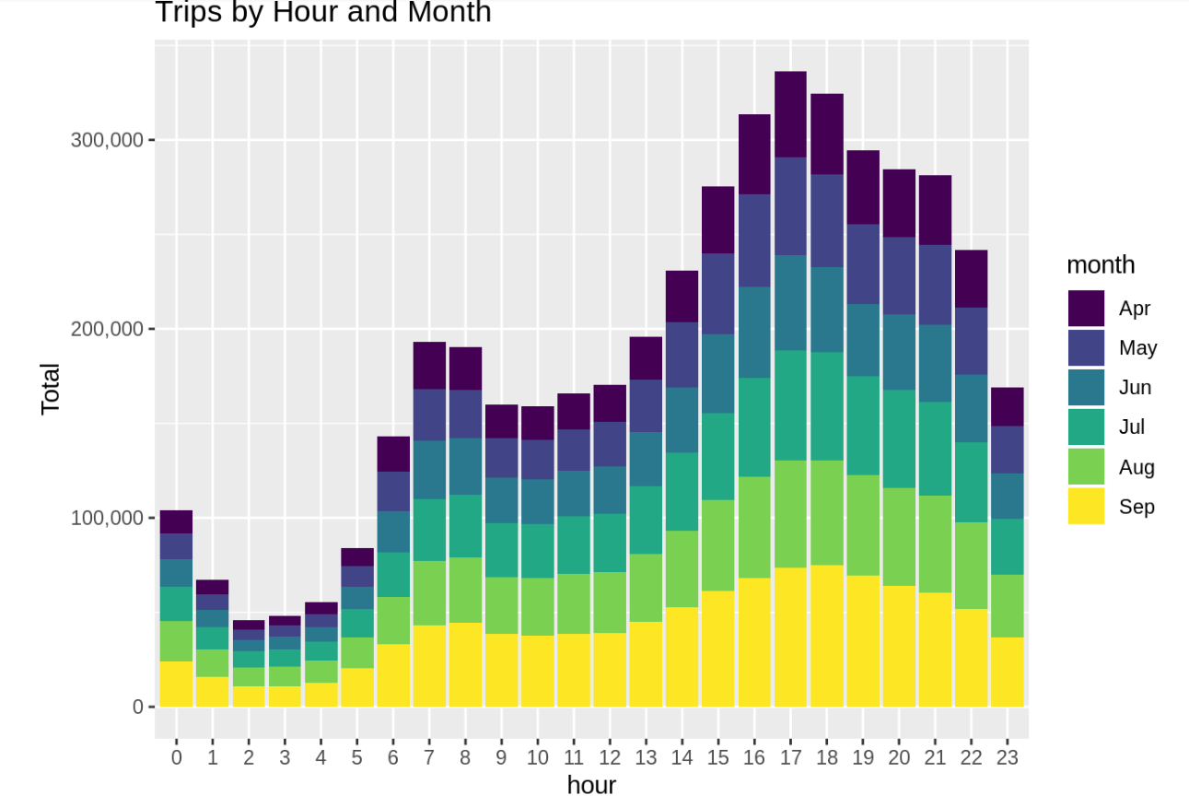
Plotting the trips by the hours as well as months

Slide 8
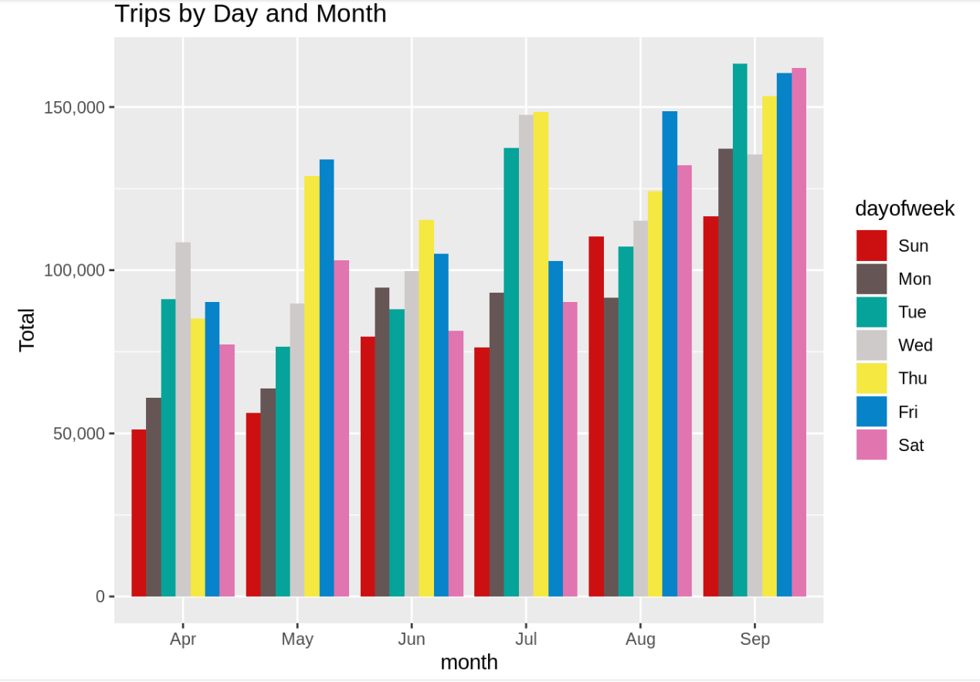
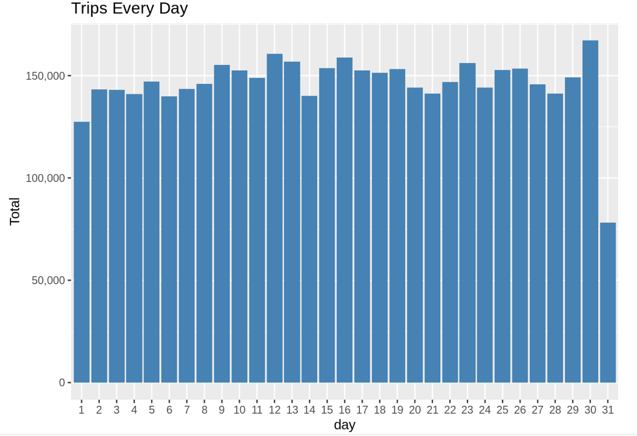
Some of the Visualization according to their month ,days or by days & months

Slide 9
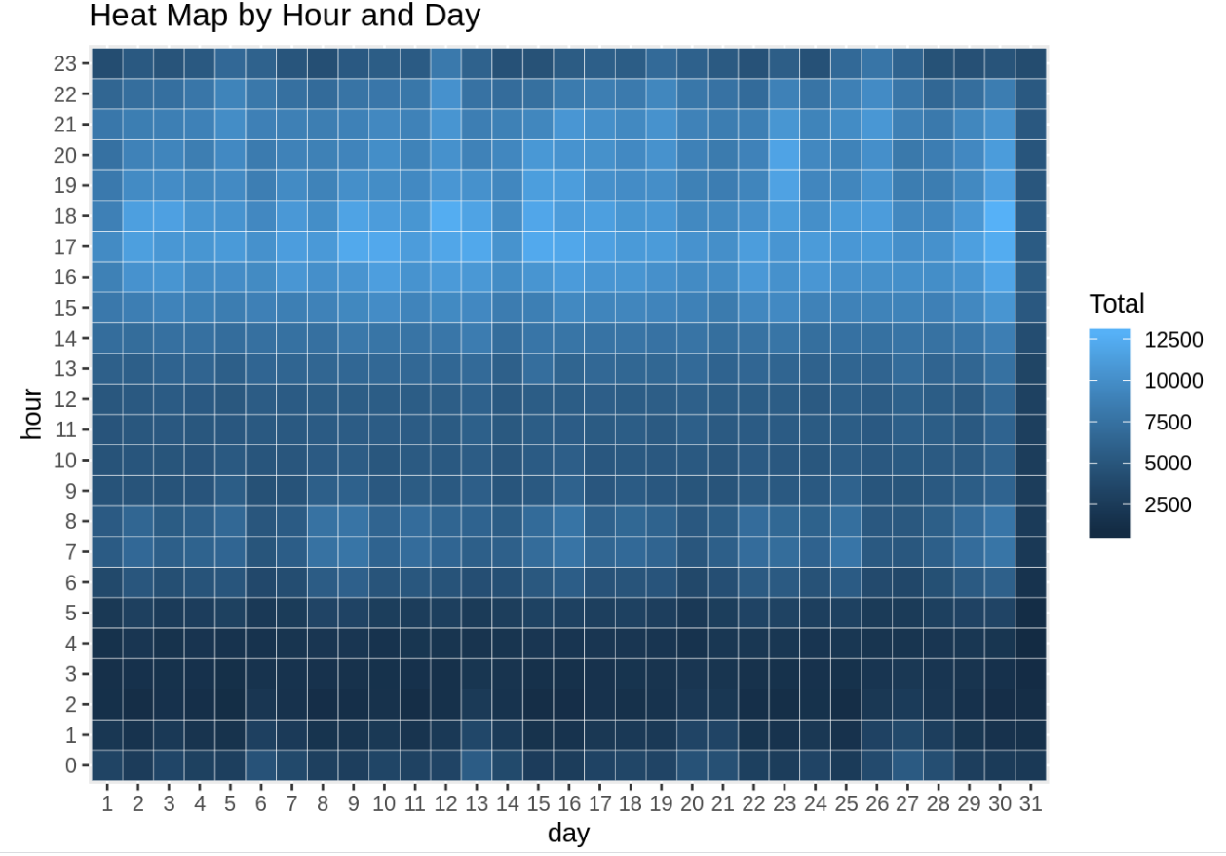
Heat Map
Plotting the data drips on the basis on Hours & days.

Slide 10
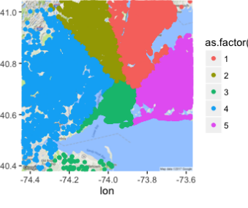
K-Means
K-means is one of the simplest unsupervised learning algorithms for clustering.
K-means clustering aims to partition n observations into k (fixed apriori) clusters in which each observation belongs to the cluster with the nearest mean, serving as a prototype of the cluster.
Training Set: Uber trip data from 2014 (April - September)
K-Means provided a good estimate of the boundary of various boroughs but with respect to the Uber Data on the training set. These boroughs were then matched against the real Boroughs and can be named accordingly

Slide 11
Conclusion
Uber Pick up Analysis is a private cab service where in each individual owning a car can serve and earn as well for quite a low price.
Through the analysis the Information obtained like:
from comparing its data for a weekday and weekend , We observe few interesting points about this service. Each month the usage of Uber services has been increasing gradually.
Uber has largely conquered the market and its way ahead than its competitors. Uber is used a lot on weekdays compared to weekends.

Slide 12
THANK YOU

